Slide 1
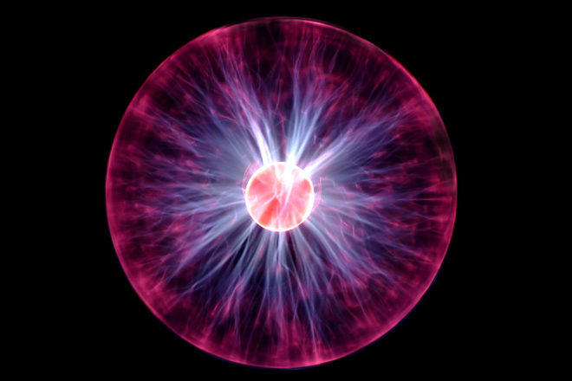
Stopping Voltage

Slide 2
Stopping Voltage
Velocity of electrons can be determined by applying a voltage and bringing the electrons to a stop.

Slide 3
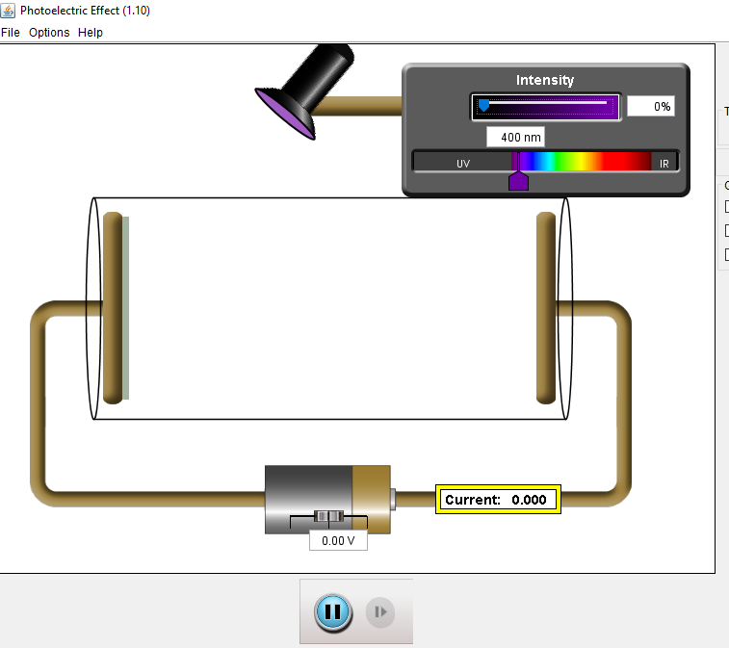

Slide 4
Example
A photoelectron is ejected with 4.5 eV of energy. Determine the voltage required to bring the electron to a stop.

Slide 5
Example
Light with a wavelength of 450 nm strikes a metal surface with a work function of 1.9 eV. Determine the energy of the photoelectron.
What is the required stopping voltage?

Slide 6
Example
In a photoelectric cell the minimum voltage required to reduce current through the cell to zero is 3.0 V. What it he maximum velocity of the electrons ejected from the photoelectric cell?

Slide 7
In a photoelectric experiment using Cesium, Madison gathered the following data:
Graph the stopping Voltage vs frequency
Use the graph to determine the threshold frequency
Use the graph to determine Planck’s constant
Determine the work function of Cesium
Stopping Voltage (V) | Frequency of light (Hz)
0.10 | 5.49 x 10¹⁴
0.70 | 6.88 x 10¹⁴
1.3 | 8.21 x 10¹⁴
2.7 | 1.18 x 10¹⁵

Slide 9
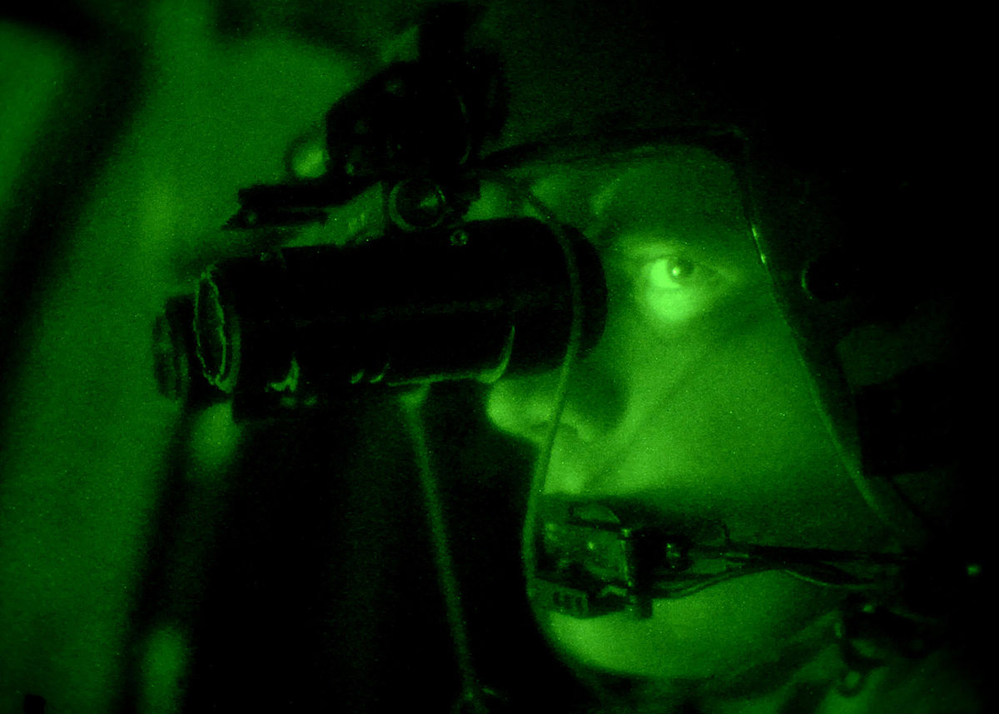
Example
Night vision goggles make use of the Photoelectric Effect and potential differences inside vacuum tubes (called Dynodes) that serves as an electron multiplier through the process of secondary emission. A photon strikes a photocathode and release an electron. The electron is accelerated across a number of Dynodes each with a higher potential difference. As the electron strikes the next dynode, because of its increased energy, it causes more electrons to be released. The result is a cascade of electrons.

Slide 10
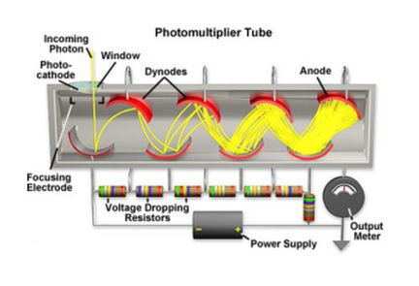

Slide 11
Each dynode is set at 100 V higher potential difference.
An incoming photon with a wavelength of 465 nm strikes a photosensitive material with a work function of 1.80 x 10⁻¹⁹ J. An electron is emitted and travels into a photomultiplier tube with 10 dynodes.
What is the kinetic energy of the original photoelectron?
How much energy does each electron gain as it crosses each dynode?

Slide 12
Homework
Page 259 #15 - 30

