Slide 1
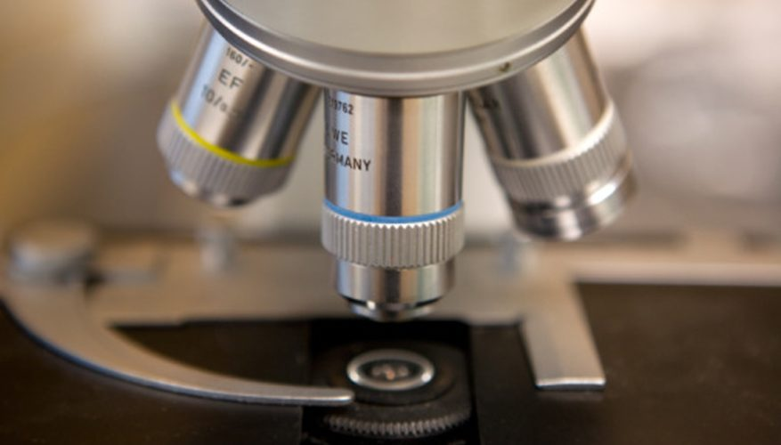
Thin Lens Equation

Slide 2
Thin Lens Equations
The properties of images can be quantitatively determined using two equations:

Slide 3
Sign Convention
Converging lenses have positive focal lengths, diverging lenses have negative focal lengths
Negative image distance means virtual image
Object distance cannot be negative
Positive height is upright, negative is upside down.
1/f = 1/d_{o} + 1/d_{i} IS NOT f = d_{o} + d_{i}

Slide 4
Example
A converging lens has a focal length of 15 cm. If an object is placed 20 cm away from the lens where will the image form?
d_{i} = +60 cm

Slide 5
Example
A candle 2.5 cm tall is placed in front of a converging lens. A virtual image is formed 30 cm away from the lens. If the image has a height of +4.5 cm determine the focal length.
d_{i} = +38 cm

Slide 6
Example
A tree with a height of 2.50 m is viewed through a pair of binoculars. The image has a height of -3.00 m when the object is 11.0 m away. Determine the focal length of the binoculars.
Is this a converging or diverging lens?
d_{i} = +6.0 m
Converging

Slide 7
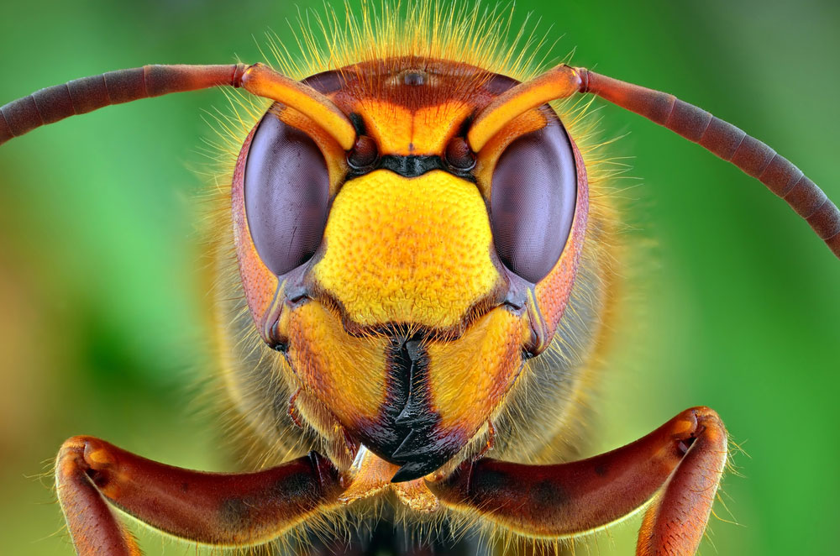
Example
A macro camera lens is used to take close-up photographs. If the lens has a focal length of 21 mm and the farthest it can be placed from the film is 31 mm determine the closest that an object can be placed if it is to be photographed.
What is the magnification of the object?

Slide 8
Determining Focal Length
Object Distance (cm) | Image Distance (cm)
15.0 | 58.0
20.0 | 31.0
25.0 | 22.5
30.0 | 20.0
35.0 | 17.5
40.0 | 17.2
In a simple lens experiment students measured the distance of a lens to an object and the recorded the location of where the image formed. The results are shown in the table.

Slide 9
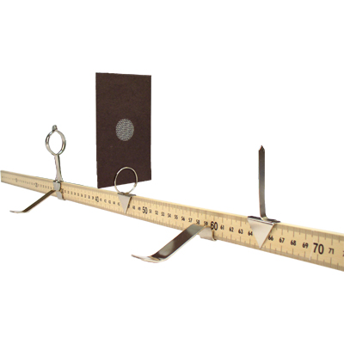

Slide 10
Sketch a graph of the data.
How can you use your linear graph to determine the focal length?

Slide 11
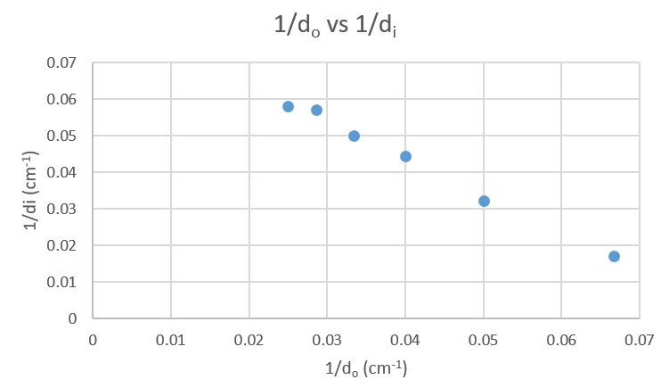
Line of Best Fit: y = -1.02x +0.0845

Slide 13
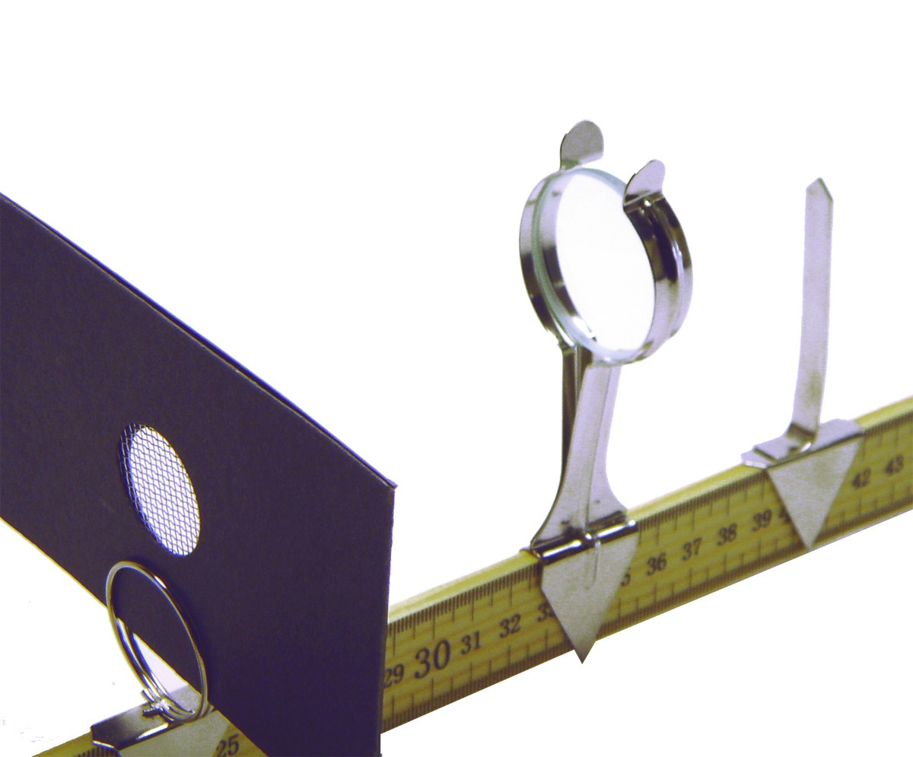
y-intercept = 0.0845 cm⁻¹
Focal length = 1/0.0845 cm⁻¹
= 11.8 cm

Slide 14
Homework
Page 217 # 3 - 14

