Slide 1
Galileo Galilie

Slide 2
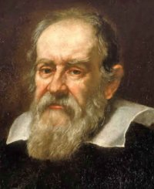
The Father of Modern Astronomy
Born February 15, 1564
Died January 8, 1642
Constructed refracting telescopes and was the first person to point a telescope to the sky
Observed Jupiter and its moons
Made observations of the Sun
Observed phases of Venus
Identified mountains and craters on the moon

Slide 3
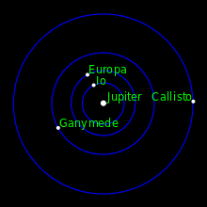

Slide 4
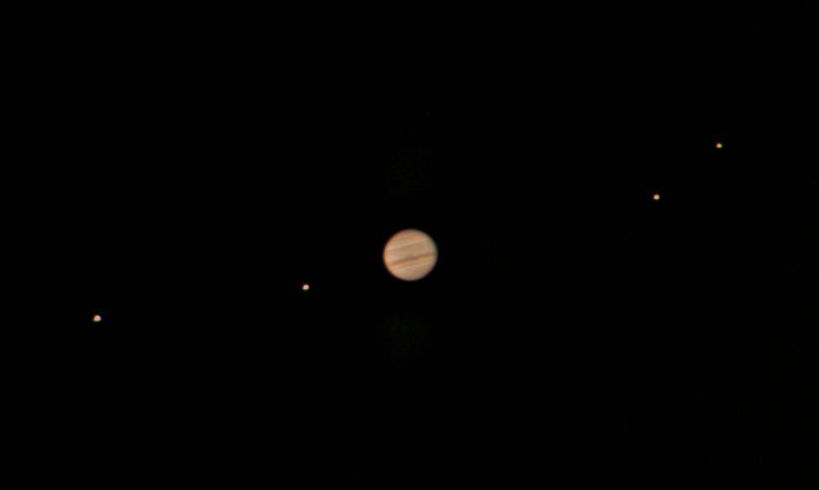

Slide 5
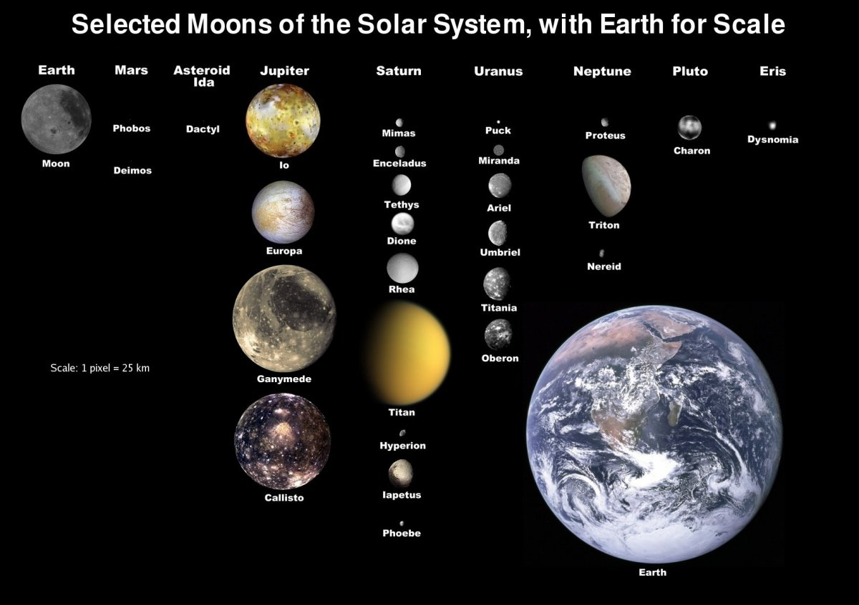

Slide 6
Io
Most volcanically active object in the solar system
Results from gravitational interaction with Jupiter
Volcanic Plumes can extend upwards over 300 km
Orbital period of 1.77 days
Tidally locked to Jupiter (same side always faces Jupiter)
About the same size as our moon

Slide 7
Europa
Smallest Galilean Moon
Crust is made of ice
May contain subsurface ocean!
Possible location for life!

Slide 8
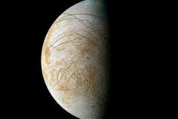

Slide 9
Ganymede
Largest Moon in the solar system
Has its own magnetic field
Larger than Mercury but only about half as massive
Mostly made of low density rocks and ice
Thin O₂ atmosphere and average equatorial temperature of -160 ºC

Slide 10
Callisto
3rd largest moon in the solar system
Roughly the same size as Mercury but 1/3 its mass
Mostly made of Ice, frozen CO₂, silicate rocks
Largest orbit of all Galilean Satellites

Slide 11
