Slide 1
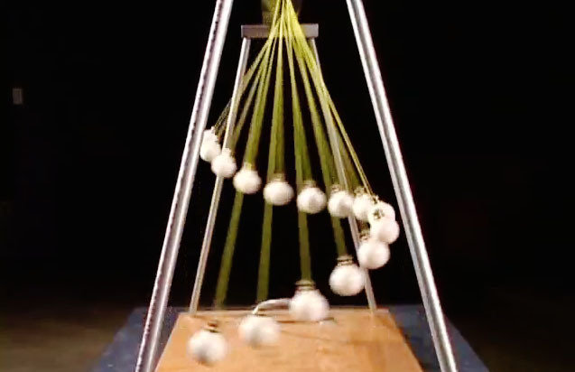
Period of Pendulums & Springs

Slide 2
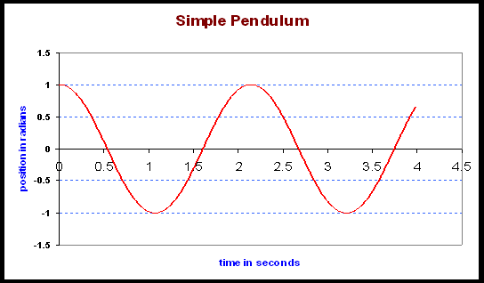
What is the linear relationship between the period of a pendulum and its length?

Slide 3
Example
Length (cm) | Period (s)
10 | 0.63
20 | 0.90
35 | 1.20
65 | 1.63
80 | 1.82
100 | 1.97
150 | 2.40
A pendulum was set at various lengths and its period was measured. The data is summarized in the table :

Slide 4
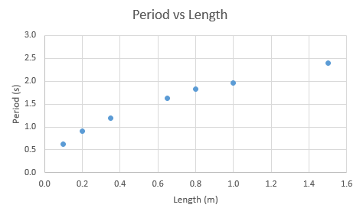
What condition must be satisfied for a pendulum to swing in SHM?
Identify the manipulated and responding variables
Graph the data. Is it linear?

Slide 5
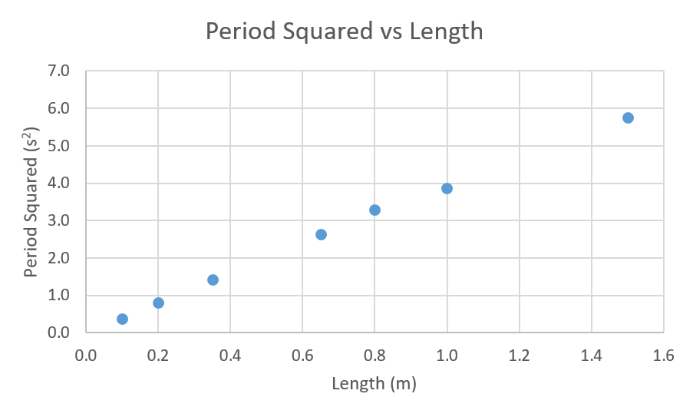
Create another column of data for T²
Create a graph of T² vs l
Write an equation in the form y = mx + b
y = 3.83x +0.089

Slide 6
What does m represent?
Determine the value of m and use it to calculate the value of g.

Slide 7
Example
A spring vibrates in SHM when various masses are placed on it. The period of the springs vibration is recorded in the table below:
Mass (g) | Period (s)
65 | 0.78
80 | 1.84
120 | 2.15
200 | 2.32
300 | 3.46
500 | 4.50
650 | 5.05

Slide 8
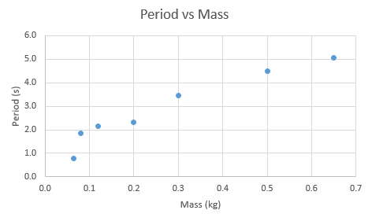
Identify the manipulated and responding variables
Graph the data. Is it linear?

Slide 9
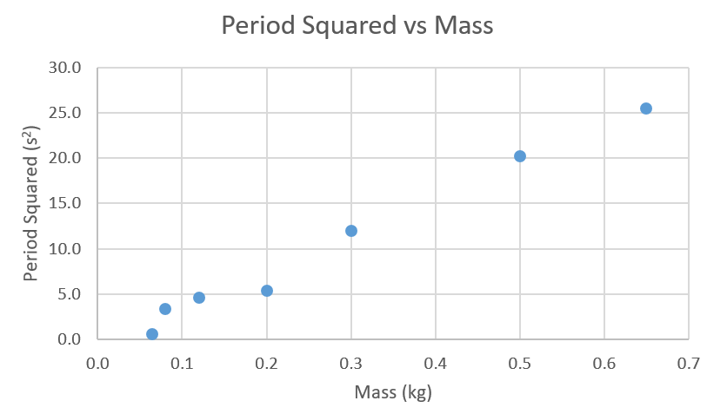
Create another column of data for T²
Create a graph of T² vs m
Write an equation in the form y = mx + b
y= 41.5x -1.12

Slide 10
What does m represent?
Determine the value of m and use it to calculate the value of k.

Slide 11
Homework
Page 218 # 10 - 20

