Slide 1
Simple Harmonic Motion

Slide 3
Definitions
Periodic Motion:
Simple Harmonic Motion:
Equilibrium Position:
Period:
Frequency:
Amplitude:

Slide 4
Definitions
Periodic Motion: Motion that repeats over a regular interval
Simple Harmonic Motion: Periodic motion caused by a restoring force which is directly proportional to the displacement
Equilibrium Position: Point of lowest displacement
Period: Time for one complete cycle
Frequency: Number of complete cycles in one second
Amplitude: Maximum displacement

Slide 6
Hooke’s Law
SHM can occur when a restoring force pushes back towards equilibrium.
The force is proportional to displacement as well as the ‘strength’ of the spring.
This relationship is known as Hooke’s Law:
F_{sp}
Equilibrium
F_{sp}

Slide 7
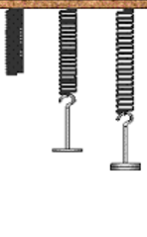
Example
A spring (k = 15 N/m) has a natural length of 30 cm. How much force does it take to stretch it to 40 cm?

Slide 8
Example
A spring (k = 17 N/m) is stretched 20 cm from its equilibrium position. Determine the acceleration a 750 g object would experience.

Slide 9
Example
When designing a rollercoaster engineers plan on stopping the 350 kg car with a spring shock absorber. If that car will be traveling at 10 m/s and must be brought to a stop it 3.5 s what should the spring constant of the shock absorber be?

Slide 10
Elastic Potential Energy
Remember that W = ΔE = Fd
Hooke’s law: F = kx
Because x and d both represent displacement we’ll just use x.
Remember that the work is the area under a Force-displacement graph.

Slide 11
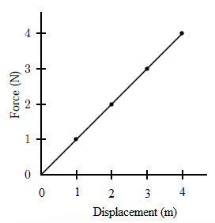

Slide 12
The area under the graph is a triangle.
Area = ½bh

Slide 13
Example
How much energy is stored in a spring that is stretched 10 cm if the spring constant is 25 N/m?

Slide 14
Example
A 100 g mass is on the end of a spring that is compressed 0.15 m. As it passes through equilibrium the mass is moving at 2.5 m/s. Determine the spring constant.

Slide 15
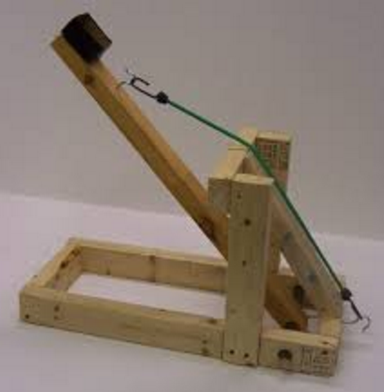
Example
A catapult is designed by using a bungee cord. The cord (k = 2500 N/m) is stretched 1.5 m and a 3.0 kg Physics Textbook is fired.
Determine the maximum height the textbook could reach.
What is the maximum range of the textbook?

Slide 16
Homework
Page 183 #1 – 7

