Slide 1
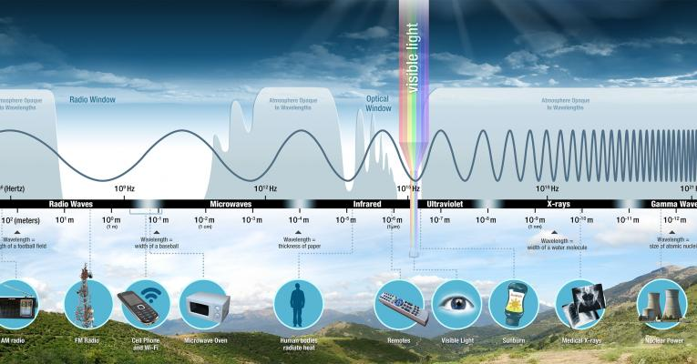
Diffraction of Light

Slide 2
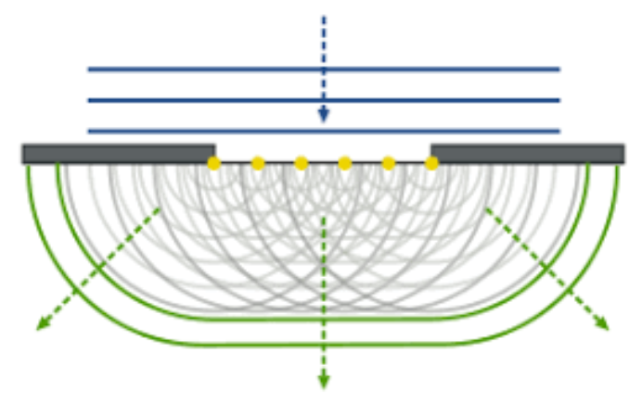
Huygen’s Principle
Every point on a wavefront is the source of wavelets that spread out in the forward direction and travel at the same speed as the wave.

Slide 3
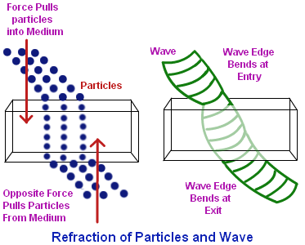
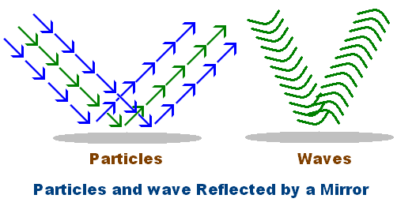
Light: Wave or Particle?

Slide 4
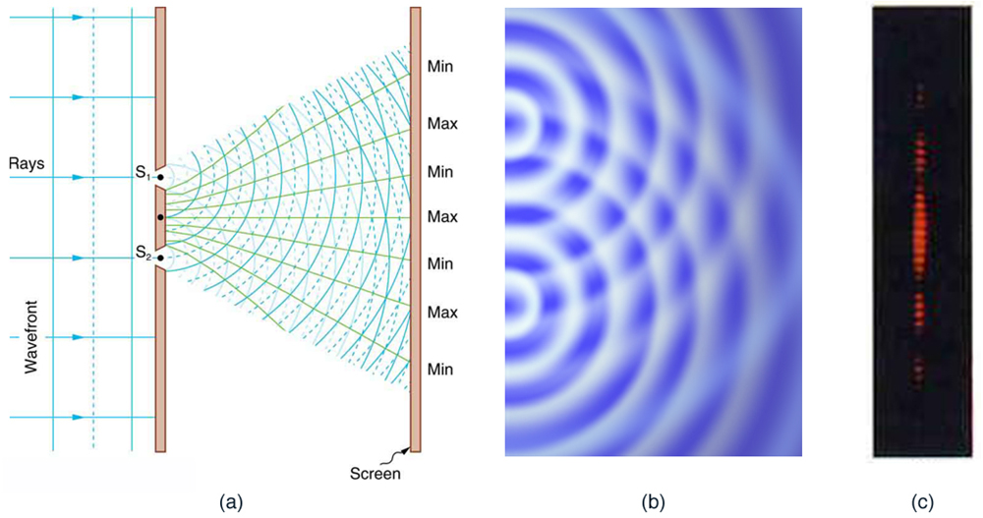
Diffraction
When waves pass through two narrow openings a characteristic interference pattern occurs.
Particles passing through the openings would not produce this pattern.

Slide 7
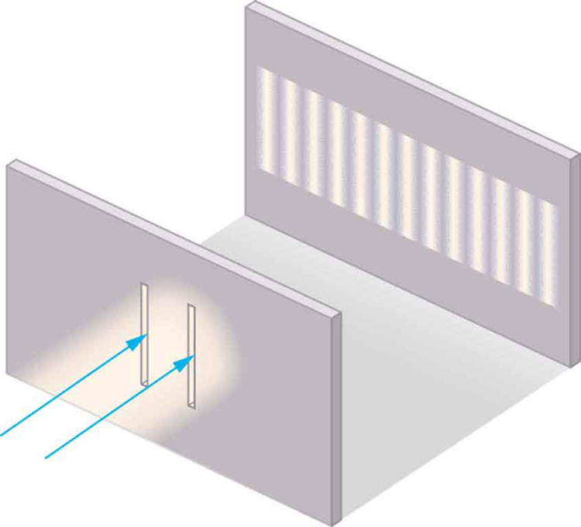
In the 1800s Thomas Young applied Huygens idea to light.
As waves pass through a slit each opening acts as a source for a new wave front.
Each wave travels from the opening and interferes both constructively and destructively with waves from other openings.
Diffraction grating is a sheet with very closely spaced lines.

Slide 8
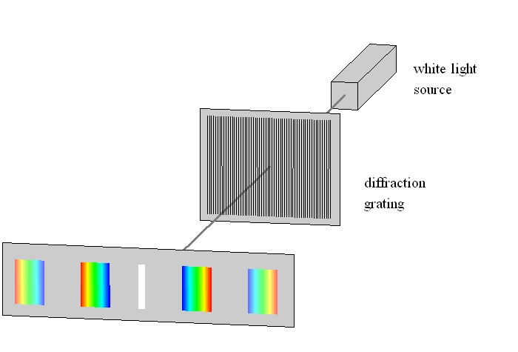

Slide 9
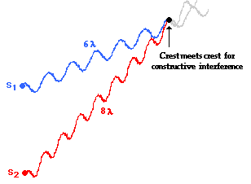
Path Length Difference
When a peak and a peak meet the waves interfere constructively (bright spot)
The difference in travel distance must be an integer of the wavelength (λ, 2λ, 3λ, . . . )

Slide 10
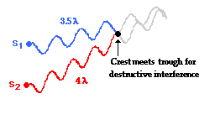
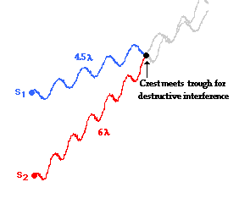
When a peak and a trough meet the waves interfere destructively (dark spot)
The difference in travel distance must be half an integer of the wavelength (¹/₂λ, ³/₂λ, ⁵/₂λ, . . . )

Slide 11
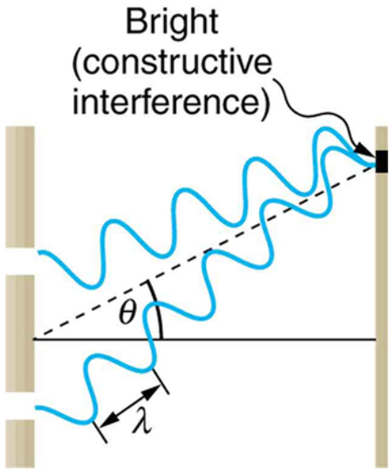
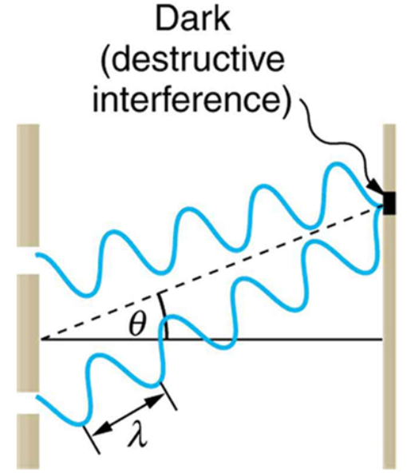

Slide 12
The length each wave travels depends on the geometry of the double slit and the screen.
P
p₁
Distance to bright or dark spot (x)
Slit separation (d)
p₂
θ
Central Axis
Length to Screen (L)

Slide 13
P
p₁
x
p₂
d
θ
θ
L
$p_{1}−p_{2}=nλ$← constructive
$p_{1}−p_{2}=\left(\frac{1}{2}+n\right)λ$← destructive
Δp

Slide 14
θ
d
$$sinθ=\frac{Δp }{d}$$
Δp
$$sinθ=\frac{nλ}{d}$$
$$λ=\frac{dsinθ }{n}$$

Slide 15
As long as θ is less than 10º
θ
d
x
θ
Δp
L
$$sinθ=nλ/d$$
$$tanθ=x/L$$
For small angles tan$θ=sinθ$
$$\frac{nλ}{d}=x/L$$

Slide 16
$$λ=\frac{dx}{nL}$$
$$λ=\frac{dx }{nL}$$
Constructive Interference

Slide 17
$$λ=\frac{dx }{nL}$$
$$λ=\frac{dsinθ }{n}$$

Slide 18
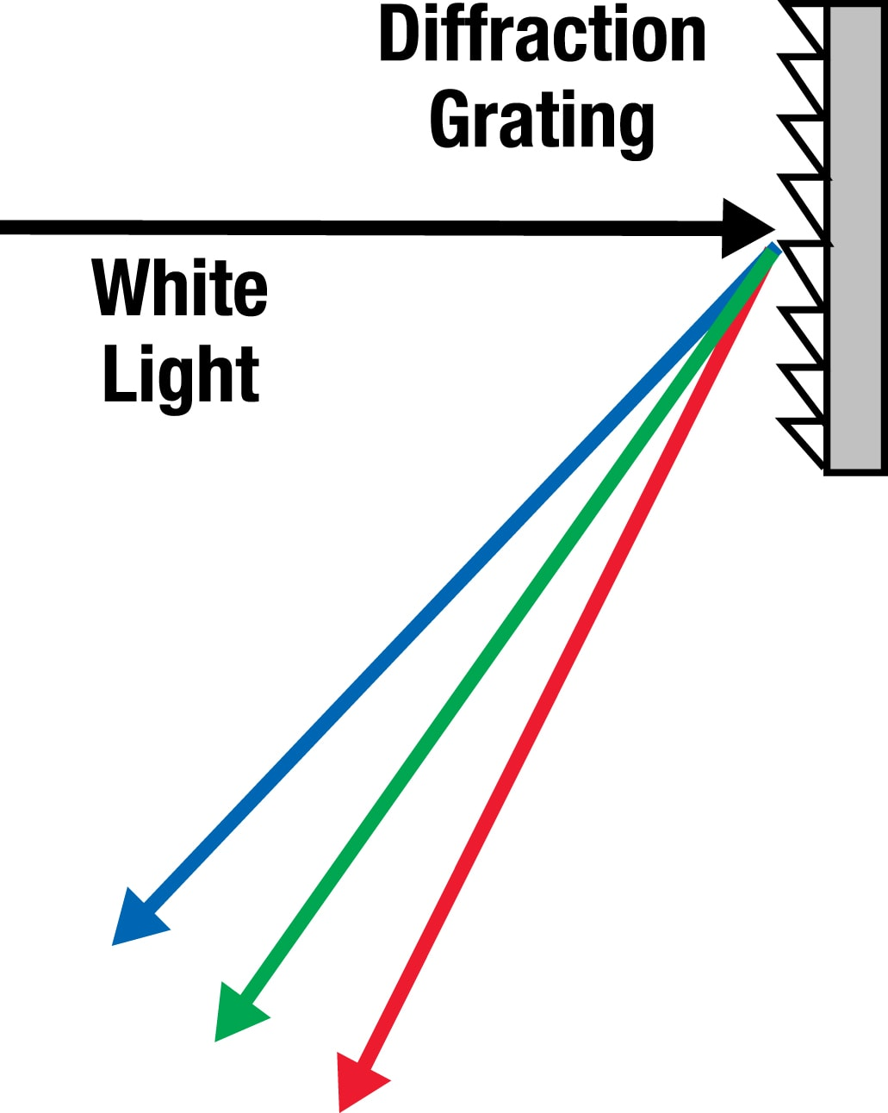
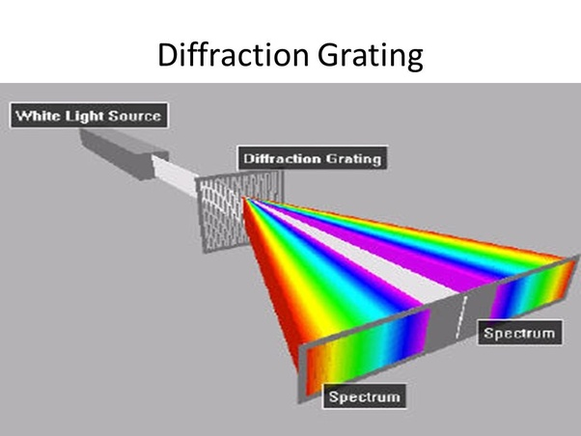
Multiple slit Diffraction
Rather than using two slits, diffraction gratings have many (thousands or millions) of closely spaced openings.
The bright regions are narrower and brighter while the dark regions are darker.
They can be transmissive or reflective.

Slide 19
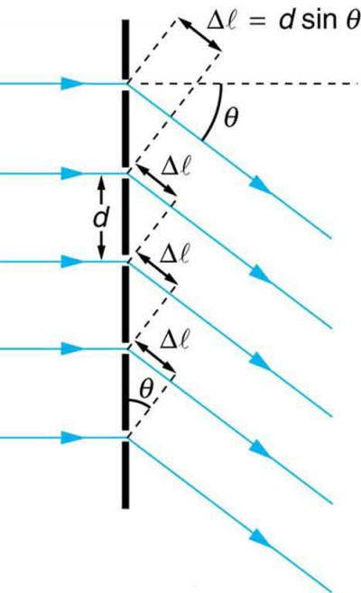

Slide 20
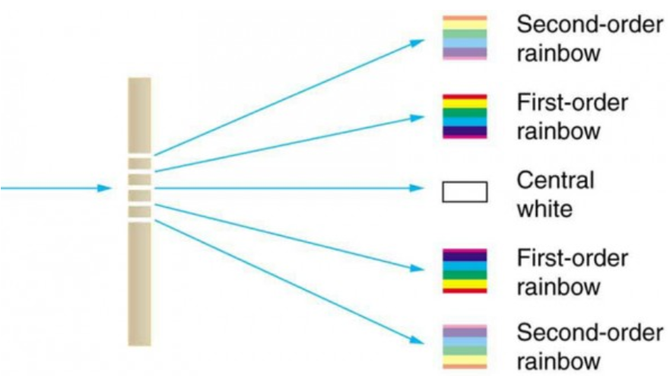

Slide 21
Example
Monochromatic light falls on a diffraction grating in which the slits are 5.45 x 10⁻⁶m apart. Calculate the wavelength of light if the 1st order maximum is produced at a 4.00º angle of deviation.

Slide 22
Example
Monochromatic light has a frequency of 4.77 x 10¹⁴ Hz and is directed on a diffraction grating ruled with 3.98 x 10⁴ lines/m. An interference pattern is produced on a screen 1.10 m from the grating. How far is the 1st order maximum from the central maximum?

Slide 23
Example
A diffraction grating with 750 lines mm apart is used to produce a series of bright and dark spots. A red laser (λ = 648 nm) is used. How many bright fringes will be seen on each side of the grating?

Slide 24
Example
A double slit is placed 85.0 cm from a screen. The 2nd order minimum is observed to be 55.0 cm from the central maximum when yellow light (565 nm) is used. How far apart are the slits?

Slide 25
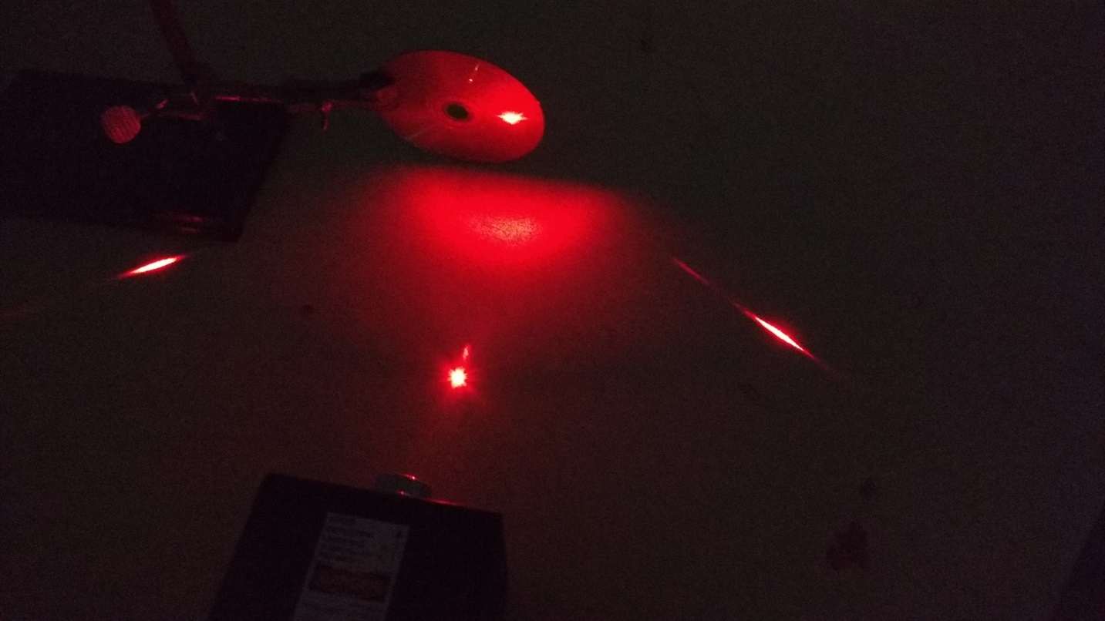
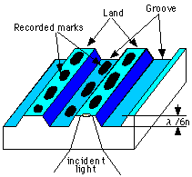
Example
A Helium Neon Laser (λ = 632.8 nm) is shown on a DVD and a diffraction pattern is observed. Use the diffraction pattern to determine the spacing on the grooves on the CD.

Slide 26
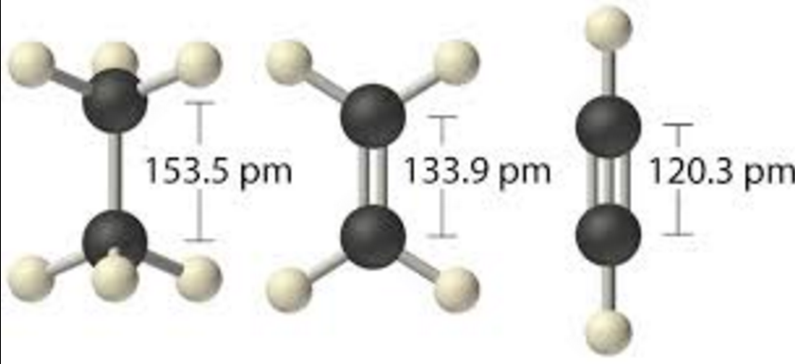
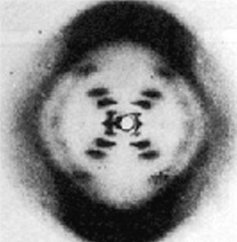
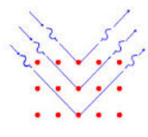
X-ray Diffraction

Slide 27
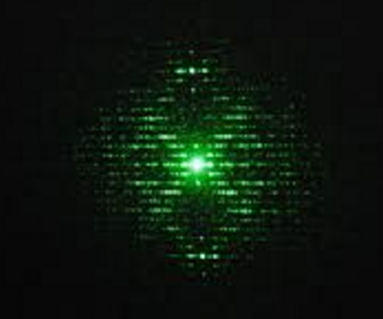
Example
X-Rays with a wavelength of 6.80 x 10⁻¹² m are used to determine the structure of DNA. If bright spots are observed 0.040 m apart on a screen 2.00 m from a DNA sample determine the spacing of the Base Pairs.

Slide 28
Transverse or Longitudinal?
Polarization provides evidence for light as a Transverse wave
Transverse waves can vibrate in any plane.
A non-polarized wave vibrates in all planes
A polarized wave vibrates in only one plane

Slide 29
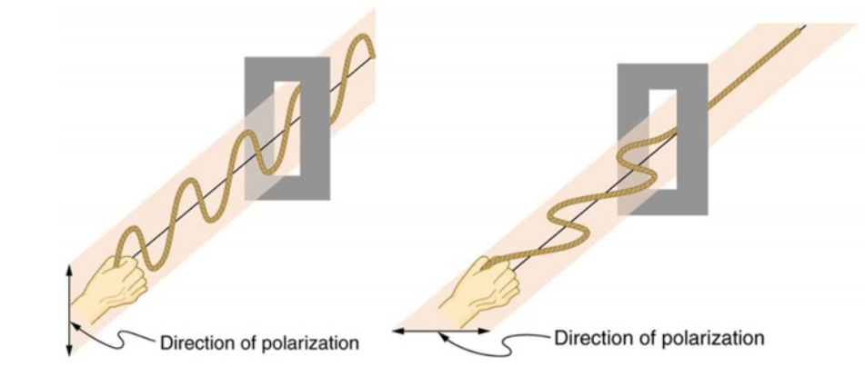

Slide 30
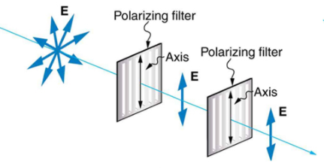
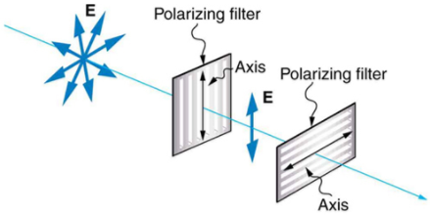

Slide 31
Example
What angle is needed between two polarizing films to reduce the intensity by 50%?

Slide 32
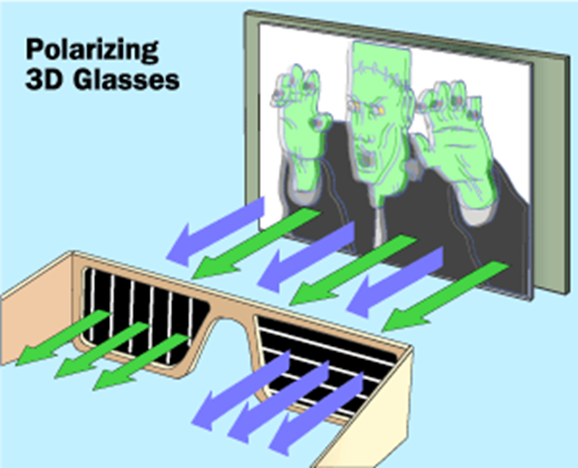
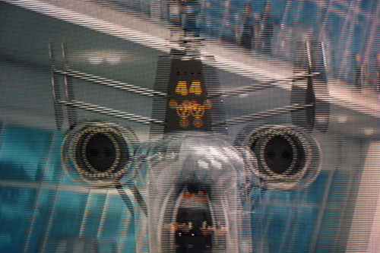
Polarizing filters absorb all but one mode (way) of vibration.
Sun glasses that reduce glare are polarized
3-D glasses use polarization to give the appearance of depth

Slide 33
Homework
Page 232 – 234 #1, 3, 5, 6, 8, 9
Page 237 #1 – 17 odd

