Slide 1
Horizontally Launched Projectiles

Slide 2
Projectile Motion
If an object travels through the air only under the influence of gravity it is a projectile.
Projectiles can be thrown horizontally or at angles.
What will the path (trajectory) of a ball thrown horizontally off a cliff be?

Slide 3
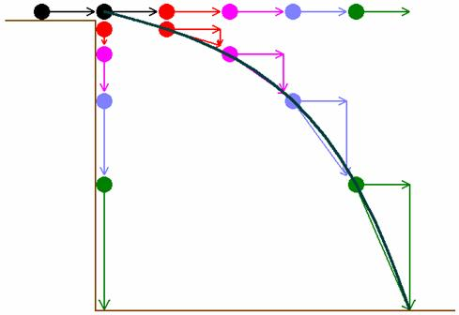

Slide 4
What did you notice about the horizontal and vertical velocity?
Is anything pulling the cannon ball horizontally? Vertically?
Gravity causes the ball to accelerate. In what direction?
Horizontal velocity is CONSTANT.
Initial vertical velocity is zero
Vertical velocity increases in the downward direction (usually given a negative sign)

Slide 5
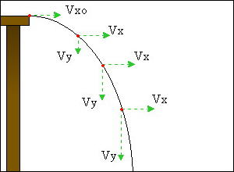
x-component of velocity is initially some value; IT DOES NOT CHANGE
Y-component of velocity is 0 at the start but grows bigger as time passes
Projectiles follow parabolic paths
Notes:
The picture is a hyperlink

Slide 6
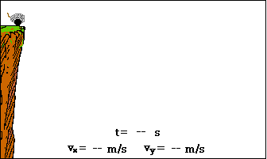
Analysis of a cannon ball!

Slide 7
Example
A baseball is thrown vertically upwards with an initial velocity of 15 m/s.
What will its velocity be at it’s highest point?
What is the ball’s maximum height?
How fast will the ball be moving after 1 s?
What will the ball’s velocity be when it strikes the ground?

Slide 8
Example
A cannon is fired horizontally from a 10 m cliff. If the muzzle velocity is 55 m/s how long is the projectile in the air? What is the range (horizontal displacement)?

Slide 9
Example
A ball is thrown horizontally from the top of a building at a velocity of 6.5 m/s. If the object takes 7.5 s to reach the ground, how high is the building?
How far from the base of the building does the ball land?

Slide 10
Example
An object is thrown horizontally from the top of a building 85.0 m high. If the object hits the ground 67.8 m from the base of the building what was the horizontal velocity of the object?

Slide 11
Example
Page 142 # 1 - 8

