Slide 1
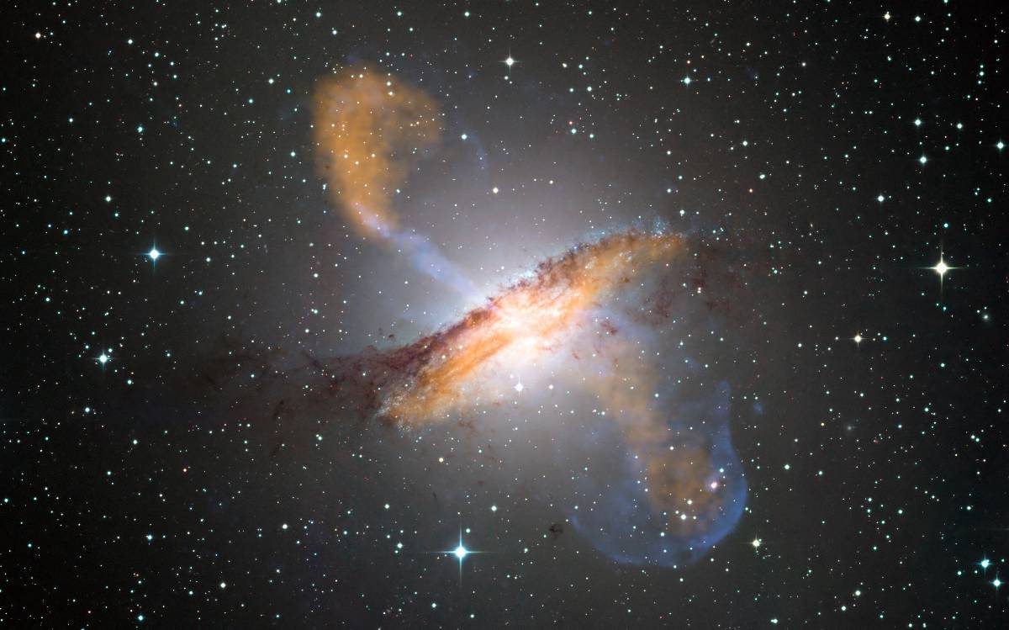
Active Galaxies

Slide 3
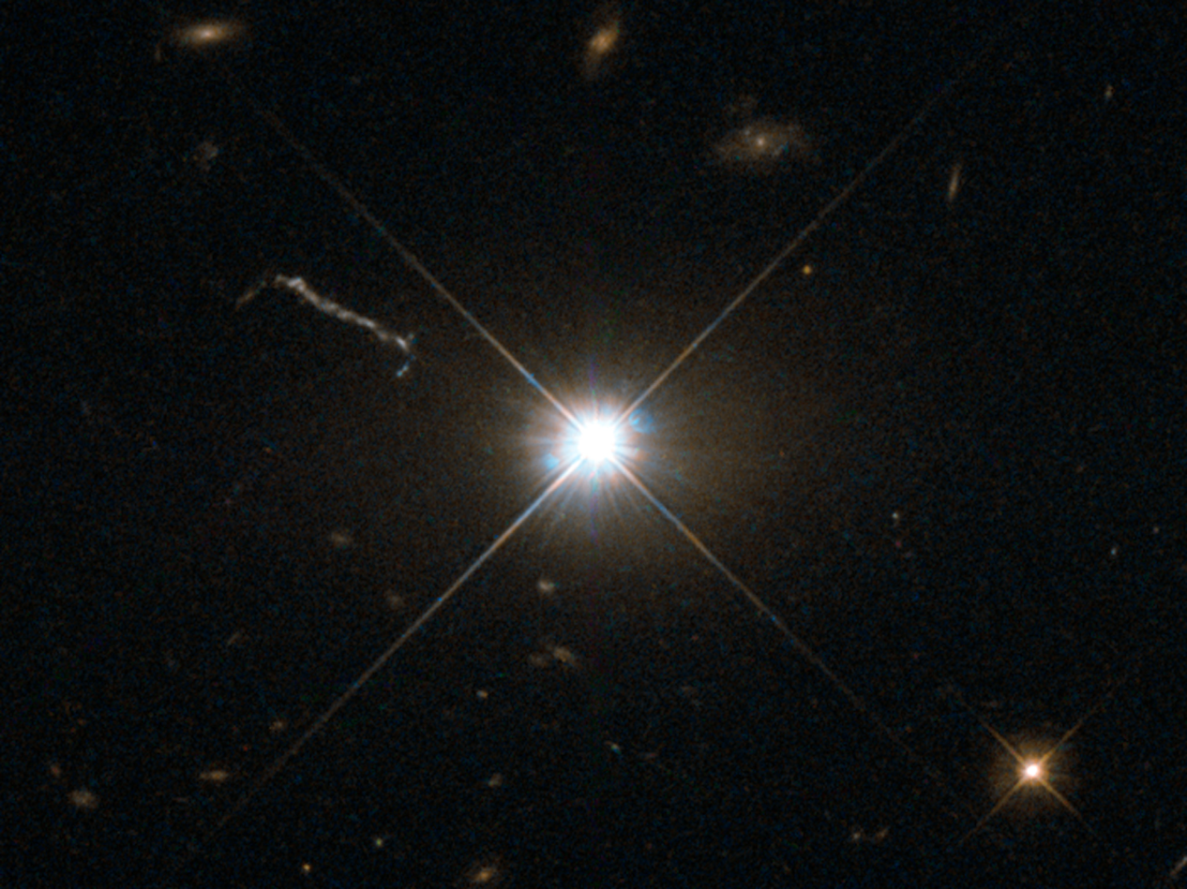
The farthest objects in the visible universe are called Quasars.
Quasi-stellar object
Up to 13 billion light years away!

Slide 4
Although no bigger than the solar system they can be up to 100 times brighter than the entire Milky Way Galaxy!
Quasar 3C 273 has a visual magnitude of +12.9 but an absolute magnitude of -26.7.

Slide 5
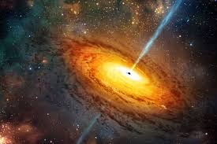
Early galaxies had a black hole at the center
Gas & dust get pulled into the blackhole
As the gas/dust speed up it starts to glow.

Slide 6
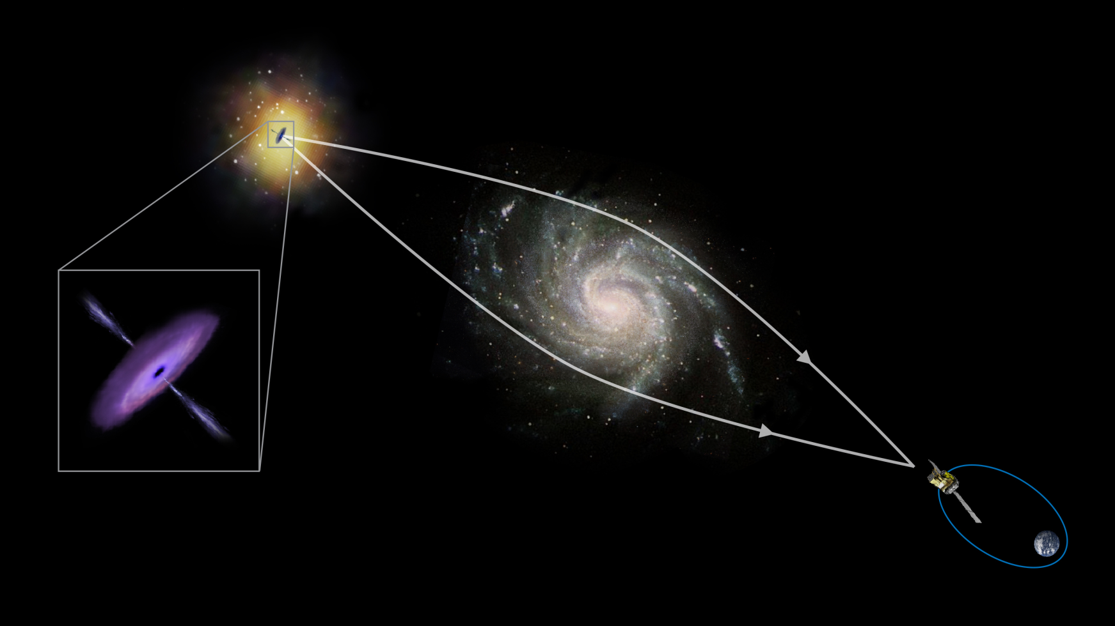
Because they are so far away, other galaxies are often in front of them.
The closer galaxy can create a powerful gravitation lens.

Slide 7
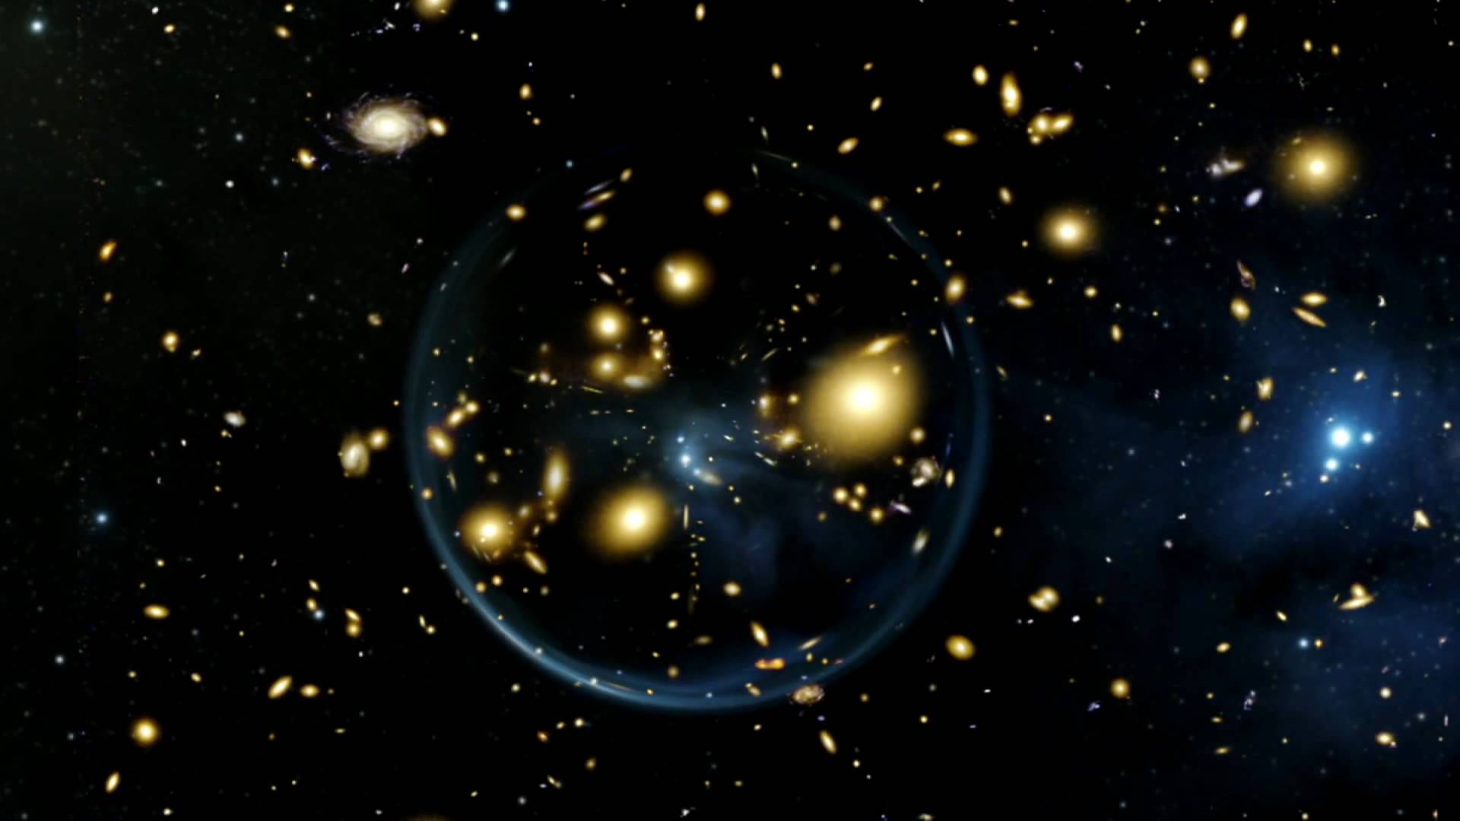

Slide 8
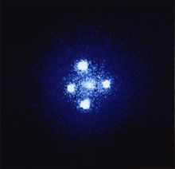
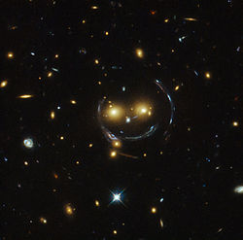

Slide 9
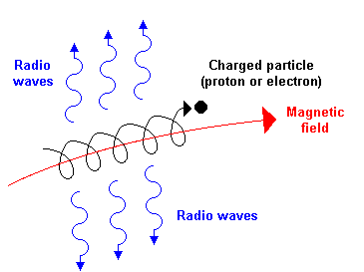
Radio Galaxy
Some active galaxies emit strong radio waves
Usually in the form of two lobes coming off the galaxy.
Due to particles accelerating around magnetic field lines.

Slide 10
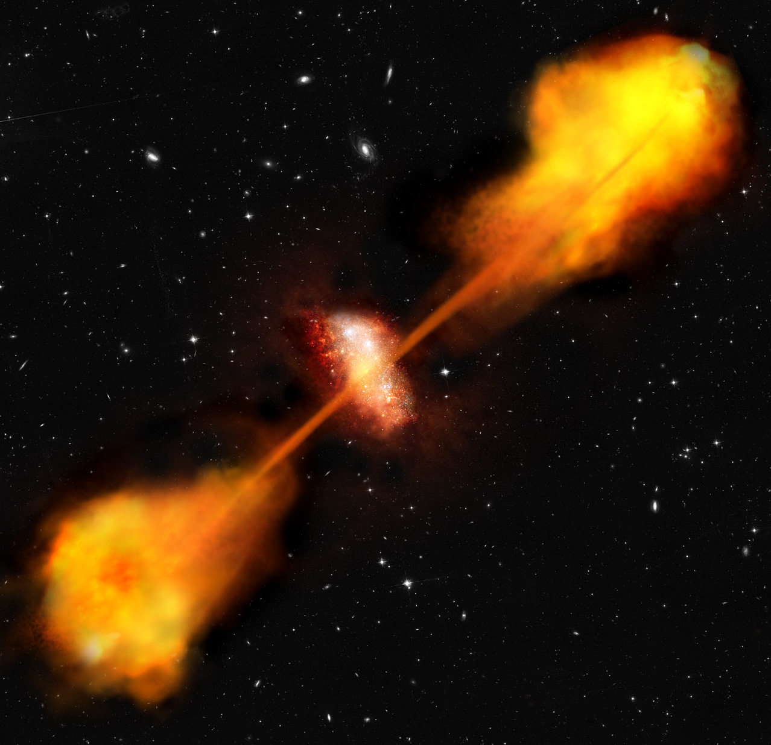

Slide 11
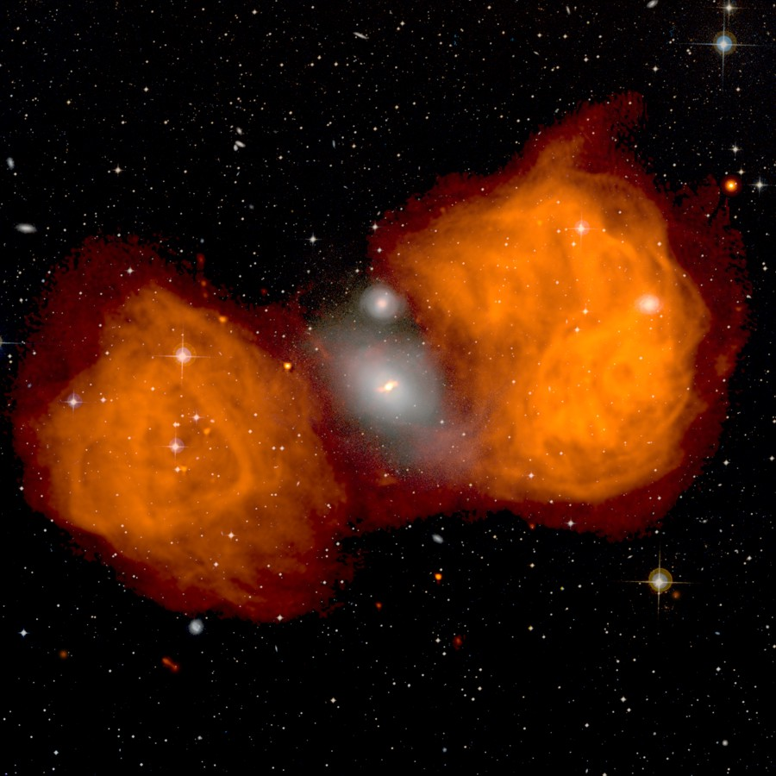

Slide 12
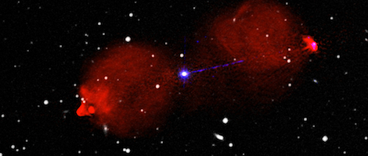

Slide 13
Homework Questions
Summarize what causes active galactic nuclei.
Why don’t we see any active galaxies near us?
What is the Eddington Limit and what does it tell us about Active Galaxies?
What is a Blazar?

