Slide 1
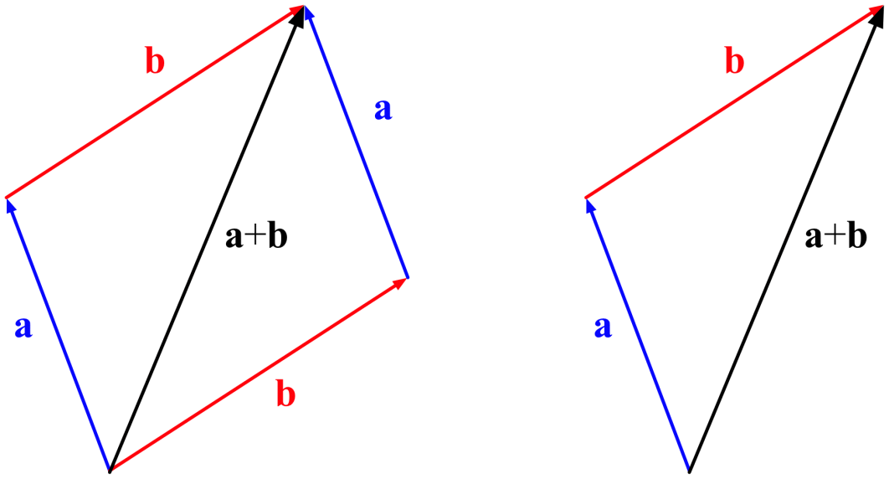
Vectors in 2D

Slide 2
Vectors are represented by arrows
Components of vectors refer to x and y parts of a vector
Individual components are combine (using Pythagorean theorem) to determine the resultant vectors
To add 2 different vectors, draw the vectors tip to tail

Slide 3
Direction
All vectors must include direction
An angle isn’t enough; 20⁰ relative to what?
We can reference the angles to either a Cartesian system (RCS) or principle axis (North, East, South, West).

Slide 4
+
-
+
-

Slide 5
N
8.0 m [60º W of N]
8.0 m [30º N of W]
8.0 m
60º
from
30º
E
W
S

Slide 6
N
8.0 m [150º]
8.0 m
150º
30º
E
W
S

Slide 7
Vector Components
Sine and Cosine are used to determine the x- and y- components of individual vectors.
20 m/s
y - component
30⁰
x - component

Slide 8
Example
A girl runs at a 30.0⁰ N of W with a velocity of 2.5 m/s. What are the x and y components of her velocity?

Slide 9
Example
A car travels with a velocity of 55 km/h at 25⁰ W of N. What are the north and east components of this velocity?

Slide 10
Homework
Page 107 #1 – 6
Page 112 #1

Slide 11
Adding Vectors
Add vectors by resolving into x and y components
1. Draw a reasonable diagram of the two vectors (head to tail)
2. Use sine, cosine, tangent to resolve each vectors into x and y components
Total all ‘x’ components.
Total all ‘y’ components
Use Pythagorean Theorem to find the resultant

Slide 12
Example
Add the two vectors.
12 km
10 km

Slide 13
Example
Add the vectors below to determine the resultant:
1.5 m/s
R
2.5 m/s
30º

Slide 14
Example
2.6 m/s
25⁰
1.4 m/s
R
45⁰

Slide 15
Homework
Page 136 #2 - 8

Slide 16
Example
A wind is blow to the East at 70 km/h. Determine the resultant velocity of an airplane travelling with a speed of 350 km/h:
North
South
East
West
If the plane flies South for 2.0 h what will its displacement be?
What direction will the plane have to head to travel directly south?

Slide 17
Homework
Page 120 #1-7

